Slide 1
National pharmaceutical distributor
FC PULSE
Together we make medicines affordable

Slide 2

25 years of development and creation
The pharmaceutical company PULSE was founded in 1996 and celebrates its 25th anniversary in 2021.
For 25 years, PULSE has become a recognized leader in the Russian pharmaceutical distribution market and has established itself as a reliable partner for manufacturers and pharmacies. PULSE continuously builds up logistics competencies in the distribution business, does not create competition for partners and helps their business develop. We strive to associate such qualities as accuracy, reliability, supply guarantees, flexible response to needs with the word PULSE in any corner of Russia.
For a quarter of a century, PULSE has been a successful company with an efficiently built system of business processes and outstanding financial performance, whose employees look to the future with confidence and make ambitious plans.

Slide 3
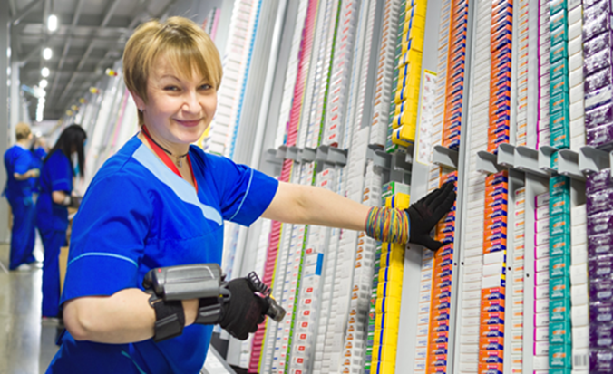
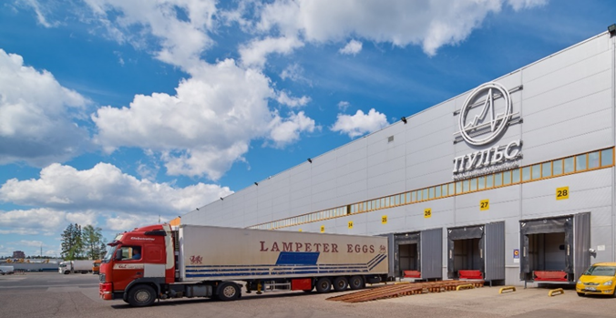
25 years of development and creation
The national pharmaceutical distributor PULSE is the leader in terms of the pace and dynamics of development: over the past 10 years, the company's turnover has grown more than 20 times, breaking the record mark of 250 billion rubles.
PULSE achieved this success thanks to 2 factors. First of all, thanks to the well-coordinated work of all divisions of the company, the professionalism and energy of the employees - a close-knit team of like-minded people, on whose shoulders lies the responsibility for fulfilling a socially significant mission - to provide the country with medicines.
The second important factor and indicator of success is the trust of PULSE partners, with whom we have managed to build long-term relationships. To date, the company has concluded more than 400 contracts with domestic and foreign manufacturers and almost 14,000 regular customers.

Slide 4
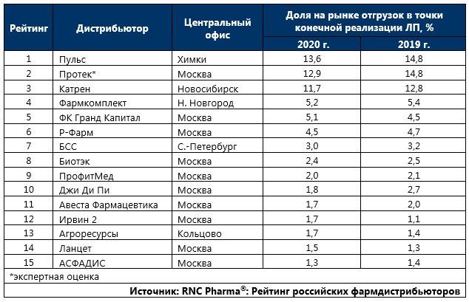
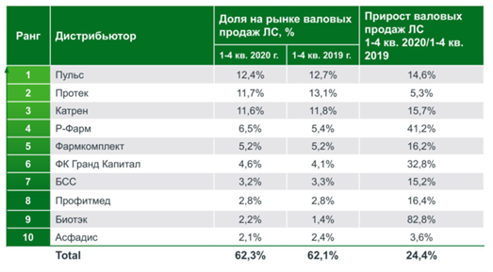
PULSE is the leader in the pharmaceutical distribution market
FC PULSE is the leader among pharmaceutical distributors both in the whole market and in the commercial segment based on the results of Q1-4 2020 (Source: DSM Group, RNC Pharma and IQVIA)
DSM Group
RNC Pharma
IQVIA
Ранг | Дистрибьютор | Объем, млрд. руб. | Прирост | Доля
1 | Пульс | 254,2 | 15% | 14,70%
2 | Протек | 241,5 | 5% | 14,00%
3 | Катрен | 239,2 | 16% | 13,80%
4 | Р-Фарм | 132,7 | 41% | 7,70%
5 | Фармкомплект | 106,7 | 16% | 6,20%
6 | Гранд Капитал | 94,9 | 33% | 5,50%
7 | БСС | 66,5 | 15% | 3,80%
8 | Профит-мед | 57 | 16% | 3,30%
9 | Ассоциация «Асфадис» | 43,2 | 4% | 2,50%
10 | Биотэк | 41,1 | 104% | 2,40%
11 | Ланцет | 38,4 | 29% | 2,20%
12 | Фармимэкс | 38,2 | 0% | 2,20%
13 | Авеста Фармацевтика | 36,9 | 12% | 2,10%
14 | Джи Ди Пи | 36,6 | -16% | 2,10%
15 | Магнит | 33,3 | 8% | 1,90%
16 | Ирвин 2 | 31,9 | 14% | 1,80%
17 | Агроресурсы | 31 | 36% | 1,80%
18 | ГК «Евросервис» | 23,4 | -2% | 1,40%
19 | ЗдравСервис | 19,7 | 14% | 1,10%
20 | Медипал-онко | 14,6 | 10% | 0,80%
21 | Фармстор | 12,4 | 29% | 0,70%
22 | Северо-Запад | 11,5 | 37% | 0,70%
23 | Фармлайн | 9,2 | 167% | 0,50%
24 | Волгофарм | 7,3 | 19% | 0,40%
25 | Мединторг | 7,2 | 6% | 0,40%

Slide 5


FC PULSE in the Forbes and RBC ratings
In September 2020, Forbes presented a rating of the 200 largest private companies in Russia. The Forbes rating includes companies controlled by individuals (over 50%). Companies are ranked by revenue for 2019.
The information provided by the companies was taken as the basis for estimating revenue. Revenue data reconciled with economic activity data and analyst estimates.
FC PULSE climbed 3 lines up in the Forbes rating. Having increased sales by 8.2%, FC PULSE demonstrates sustainable development, in contrast to 55 companies out of 200 rating participants, which worked in the red in 2019
(Source: https://www.forbes.ru/rating/409143-200-krupneyshih-chastnyh-kompaniy-rossii-2020-reyting-forbes)
In October 2020, RBC published a rating of the 500 largest companies in Russia by revenue. FC PULSE improved its position in the ranking, moving up from 79th to 72nd place.
The growth in revenue of FC PULSE at the end of 2019 compared to 2018 amounted to 8% - 201 billion rubles. against 186 billion rubles.
In order to get into the rating of this year, the company needed to receive net revenue of at least 22.55 billion rubles, which is 4.6% higher than last year's lower bar for reaching the rating - 21.55 billion rubles.
A company may not be included in the rating even if it is satisfied with the amount of revenue to pass in the rating in the event of information opacity. The priority for the financial indicators of the rating is given to the consolidated financial statements of the group under IFRS. (Source: https://pro.rbc.ru).
FC PULS prepares financial statements in accordance with international IFRS standards, and the auditor's report of a respected company from the Big Four confirms that FC PULSE has an effective process and data control system.

Slide 6


PULSE group of companies
The PULSE group of companies includes the parent company FC PULSE and 13 subsidiaries located in St. Petersburg, Bryansk, Volgograd, Voronezh, Yekaterinburg, Irkutsk, Kazan, Krasnodar, Krasnoyarsk, Novosibirsk, Samara, Khabarovsk and Yaroslavl.
PULSE * has been preparing reporting in accordance with International Financial Reporting Standards (IFRS) since 2017. The auditor of the financial statements is a company from Big 4.
* IFRS financial statements are provided to PULSE partners after signing a confidentiality agreement

Slide 7
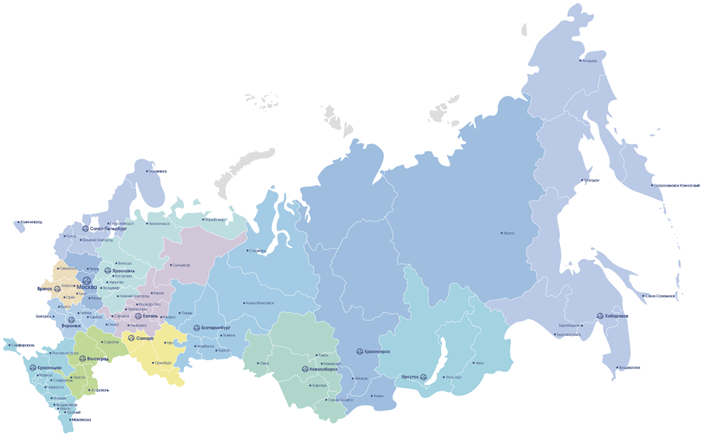
FC PULSE logistics network
Since 2001, the PULSE network of regional companies has been actively expanding.
Currently, a unified PULSE logistics network has been formed, which includes a central distribution logistics complex in the Moscow region and 13 regional logistics complexes throughout the Russian Federation.

Slide 8
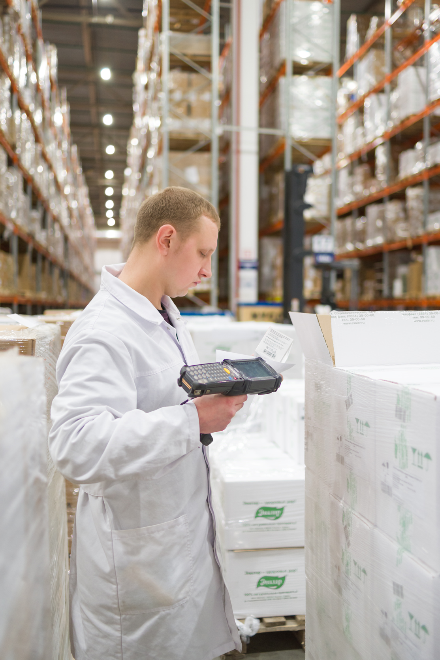
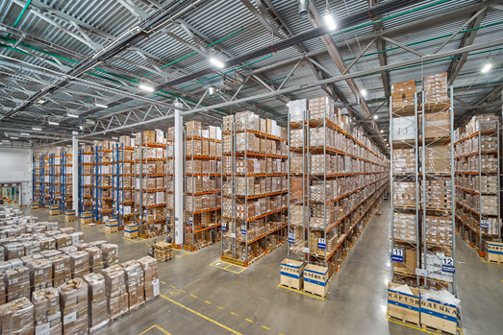
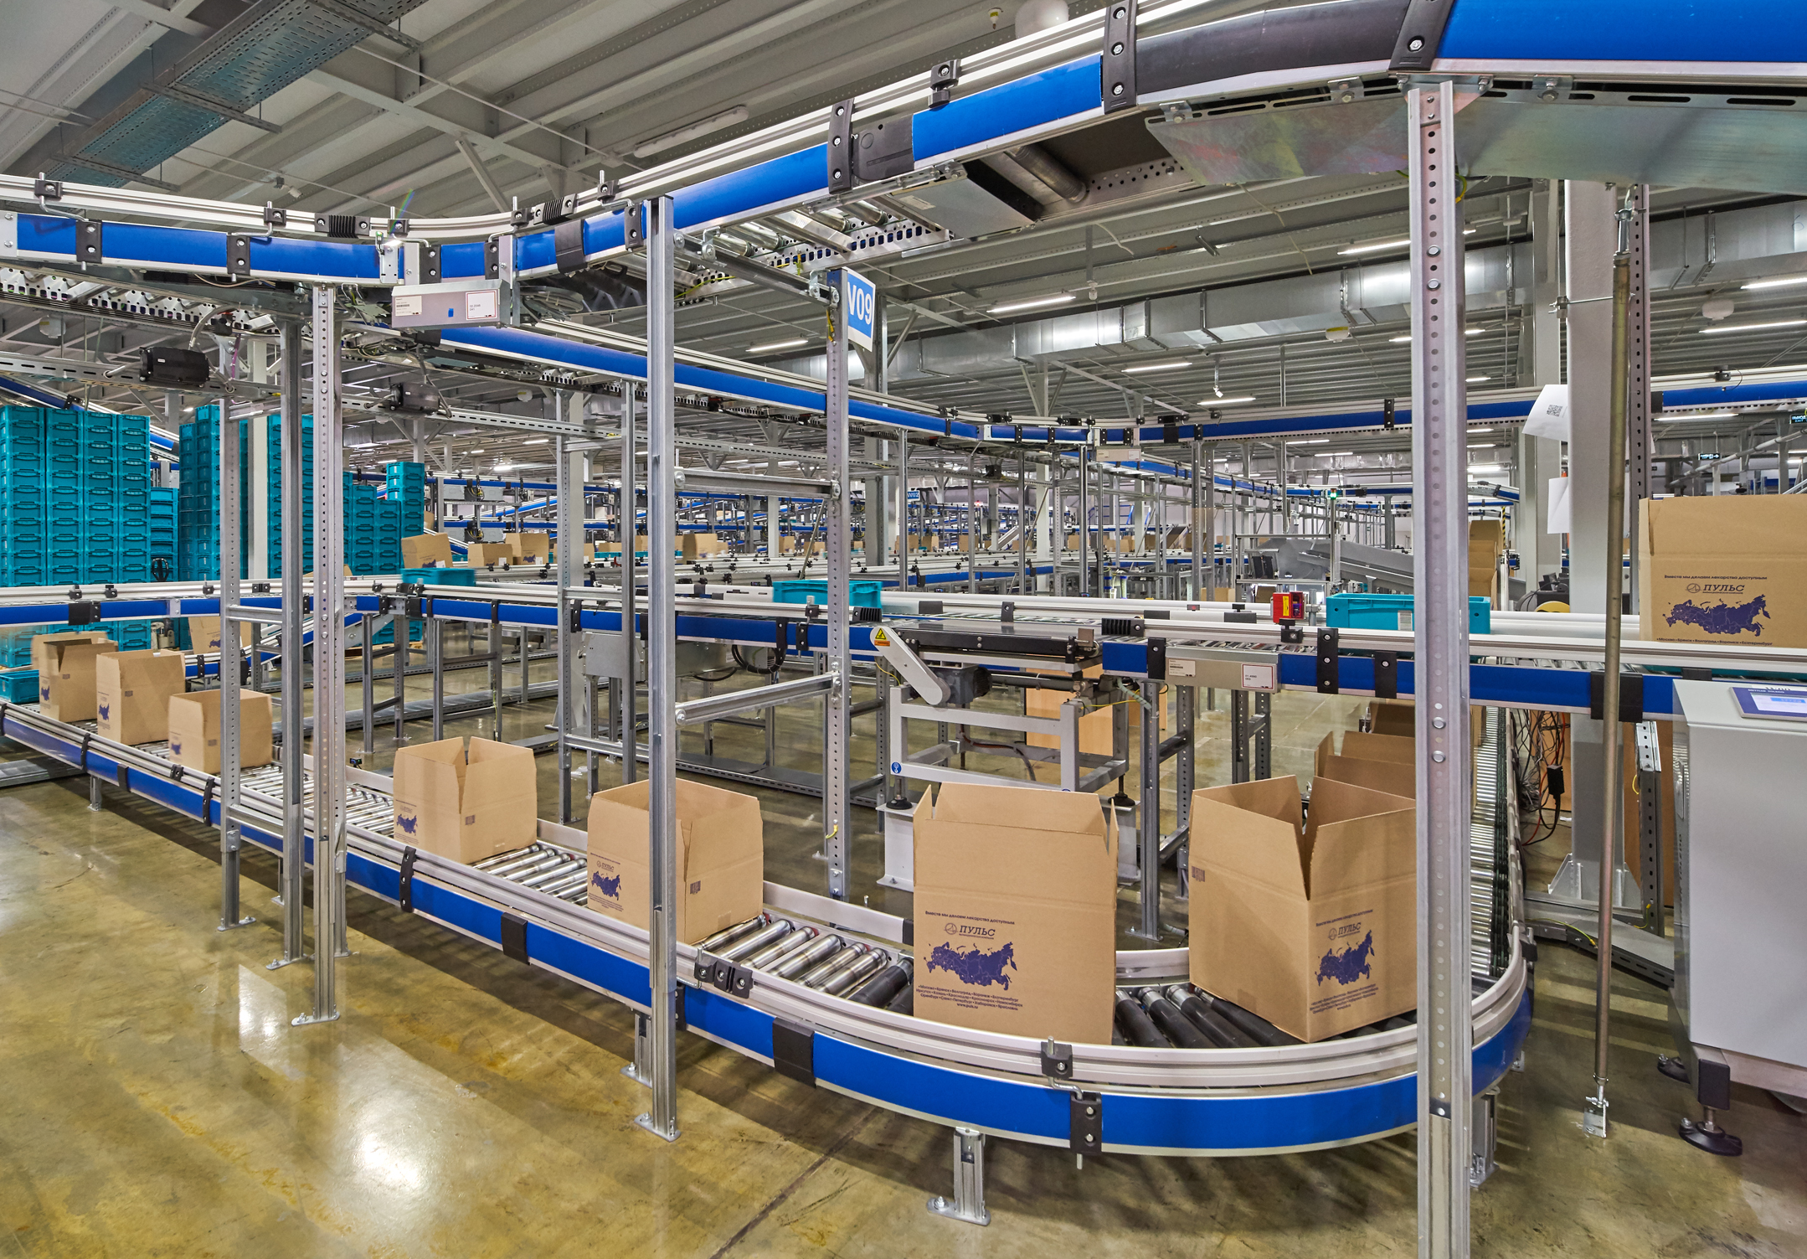
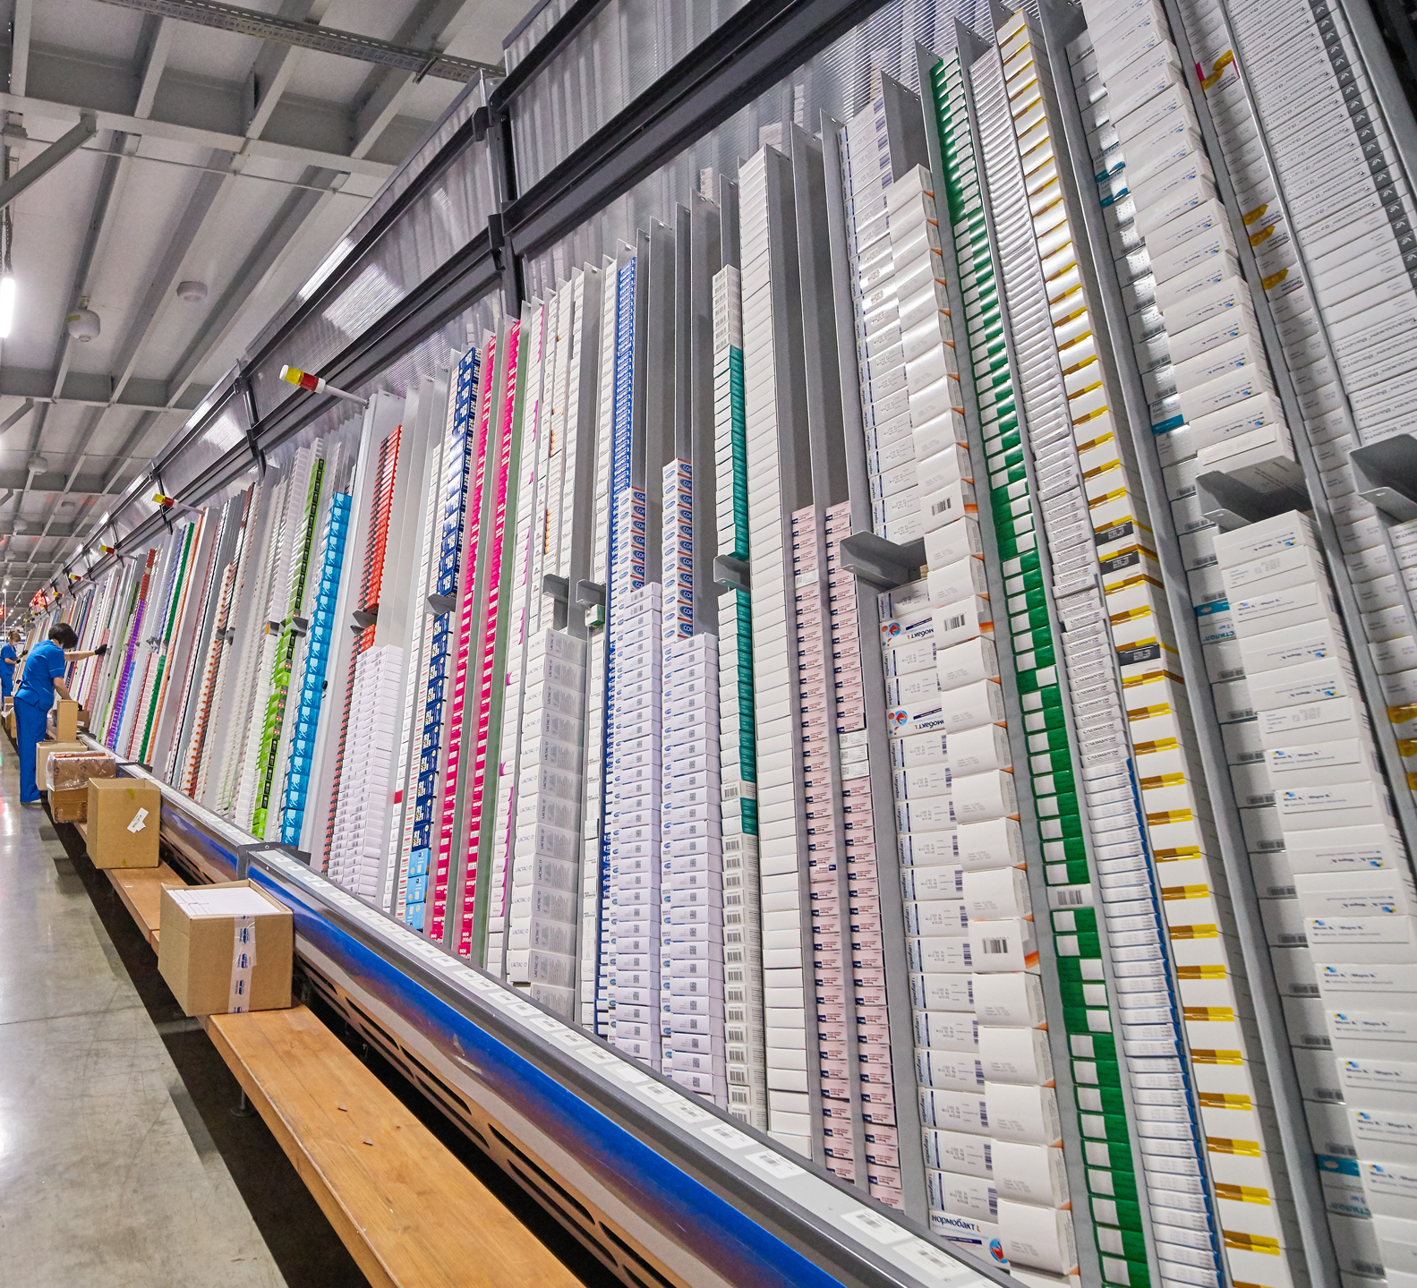
FC PULSE logistics network
The total area of ​​certified warehouse space is 100.307 m2.
Logistic complexes in Moscow, St. Petersburg, Krasnodar, Yaroslavl are equipped with modern powerful automated conveyor lines.
FC PULS is the leader in terms of the number of delivery points: every fifth package sold through 58 000 pharmacies throughout Russia - from Kaliningrad to Anadyr, is delivered by FC PULSE.

Slide 9
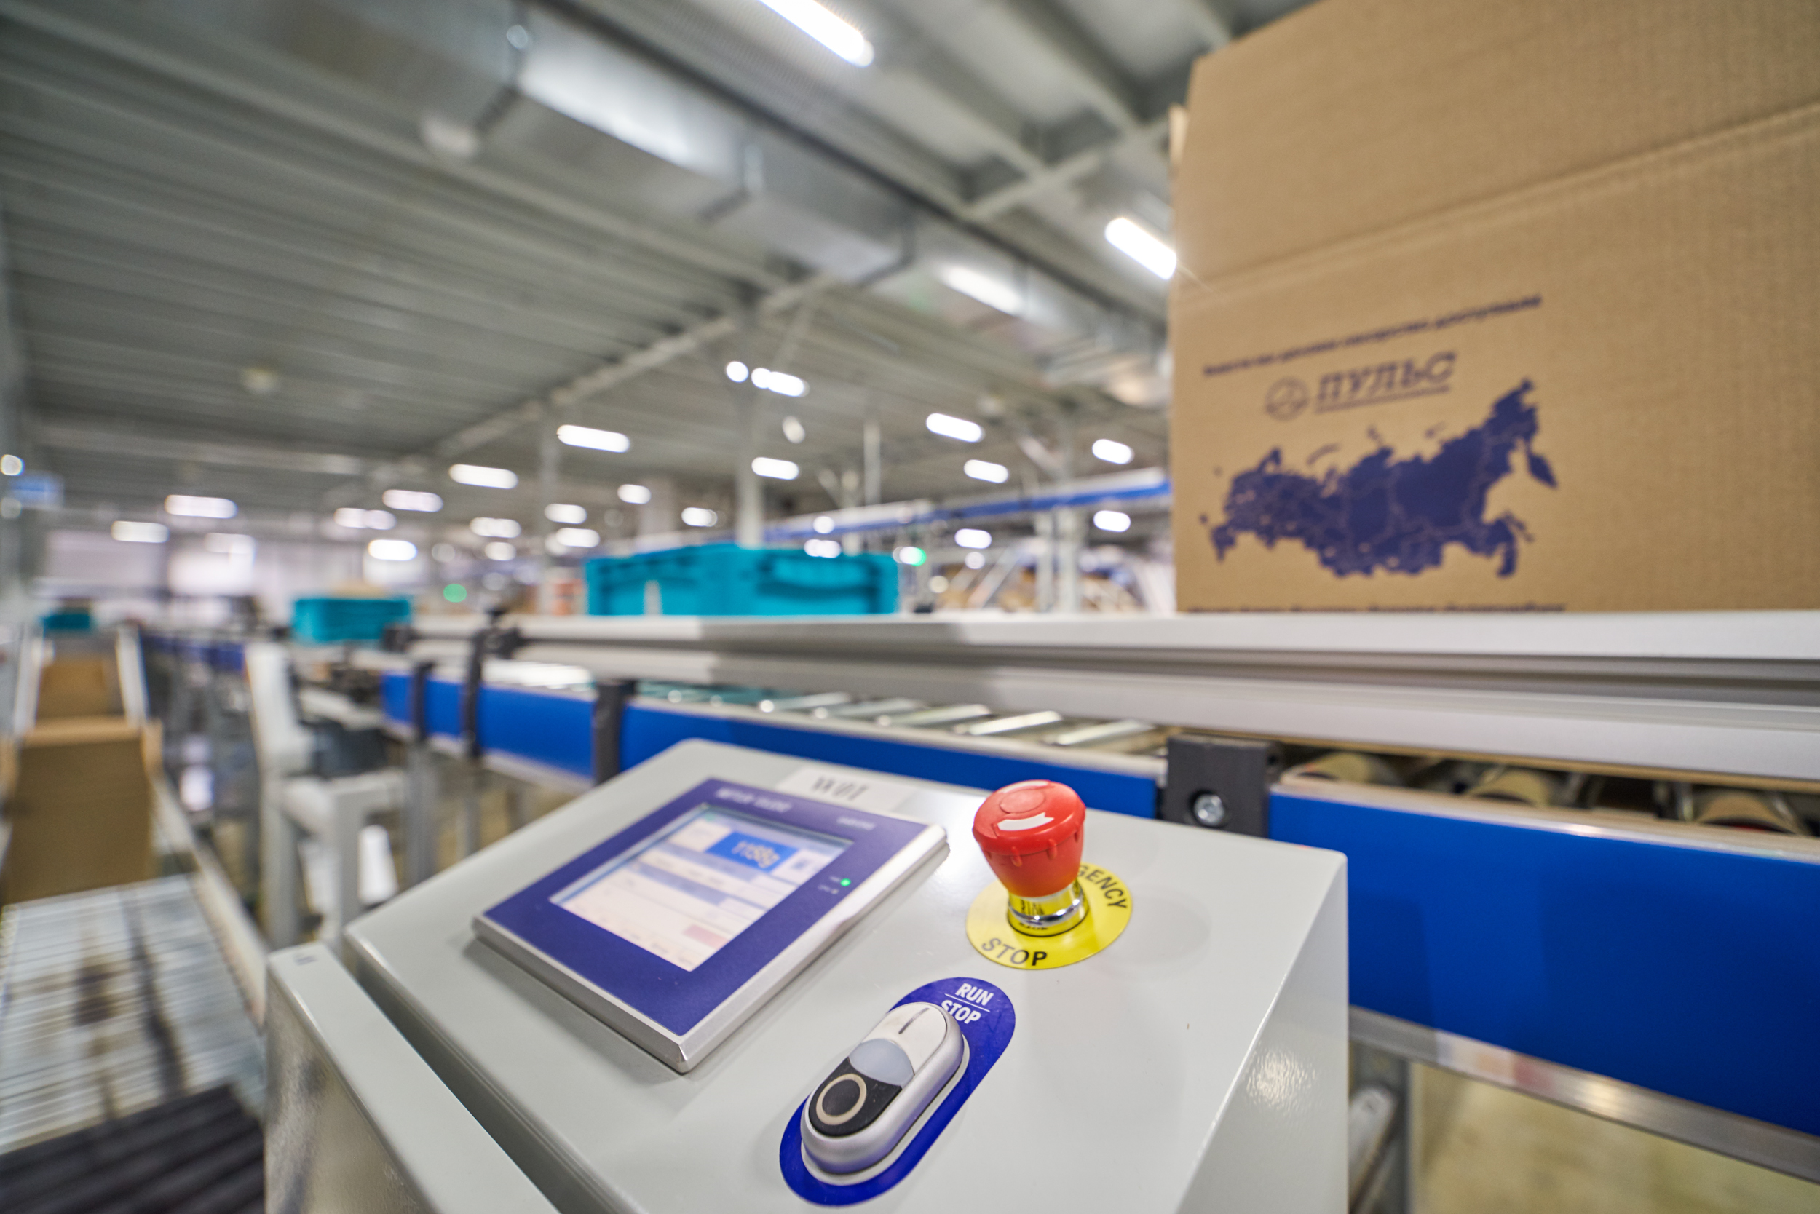
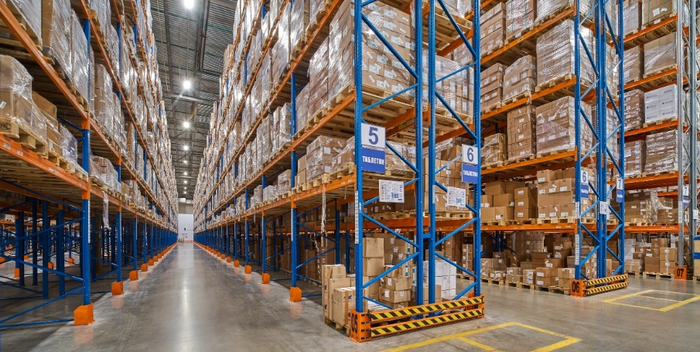
Logistic system FC PULSE
The PULSE logistics system ensures the storage and transportation of pharmaceuticals in strict compliance with the manufacturer's requirements and compliance with all required cold chain regimes at all stages. Compliance with GDP standards in transport and warehouse logistics guarantees the safety and quality of pharmaceuticals during storage and delivery.
The engineering systems, monitoring systems, temperature control, humidity control systems, ventilation systems automation, as well as automation systems responsible for controlling the storage and circulation of medicinal products makes it possible to create warehouse areas that meet the most stringent standards.

Slide 10
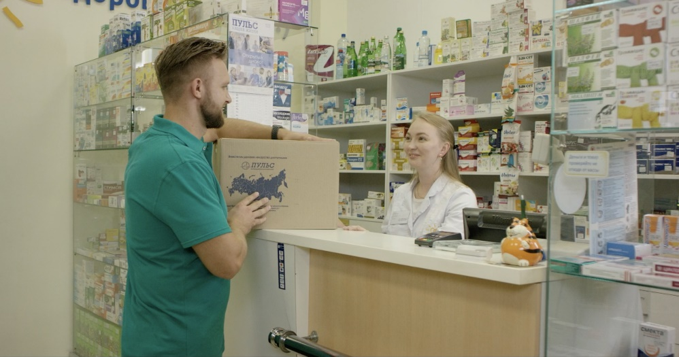
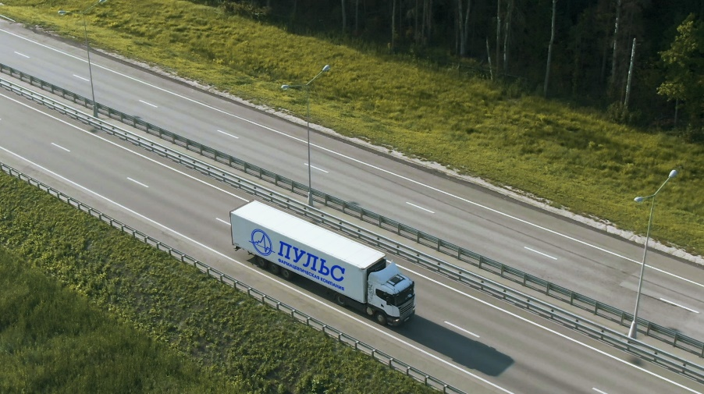
FC PULSE is a reliable partner
More than 3,000 qualified employees at PULSE take care of providing pharmacies with the best commercial conditions combined with the highest customer service.
We are ready to offer logistics services not only to large, but also to medium-sized pharmacy chains, single pharmacies, manufacturers and Internet sites. For each category, we implement individual cooperation programs.
We are responsible for the proposed projects. The success of our partners is our success!

Slide 11






Innovation hub
Digitalization is one of the key business challenges.
To implement a 3PL project and provide e-commerce sites, PULSE uses complex solutions for the collection and processing of huge amounts of data; IT technologies that ensure close interaction with partners at the level of accounting and warehouse systems; automated exchange between IT systems of the PULSE company and IT systems of partners using electronic document management.
In this we see the synergy of the distribution and logistics business.

Slide 12
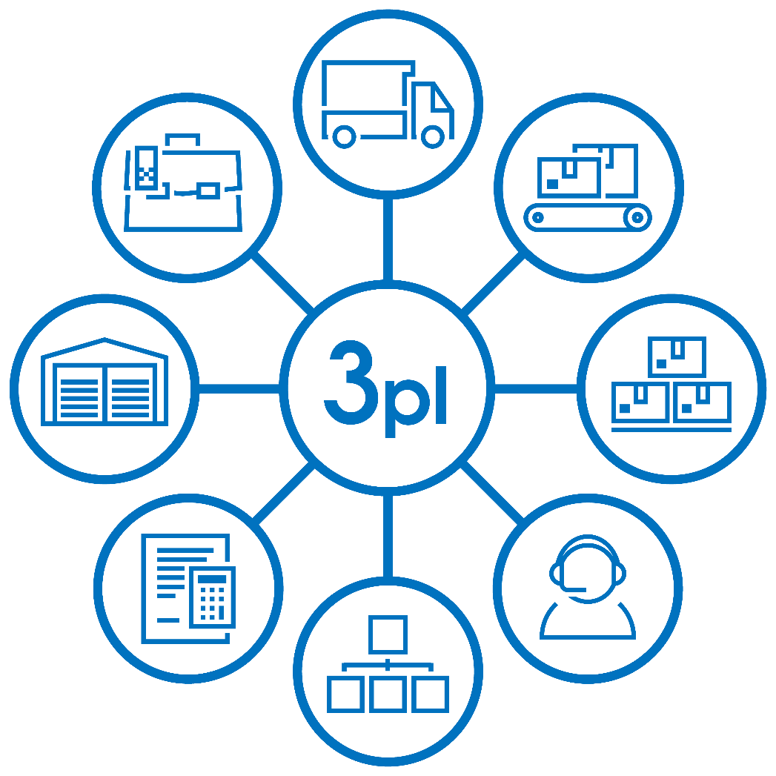
Project "3PL"
3PL (Third Party Logistics) is a complex of logistics services that includes delivery, storage, inventory management, order picking and delivery to pharmacies including integration with partner IT systems
The development of 3PL logistics is one of the priority strategic areas of business. The daily goal of the PULSE team is to develop solutions that bring partners economic sustainability and give full control over business operations.
Benefits of cooperation with PULSE:
- collection of orders at all 14 regional warehouses of the PULSE company
- delivery of collected orders to consignees in compliance with all contractual conditions in any of the regions of the Russian Federation
- automated transfer of information at all stages to the IT-system of partners
In 2020, within the framework of the 3PL project, more than 290,000 customer shipments were carried out to more than 7,000 delivery addresses.

Slide 13
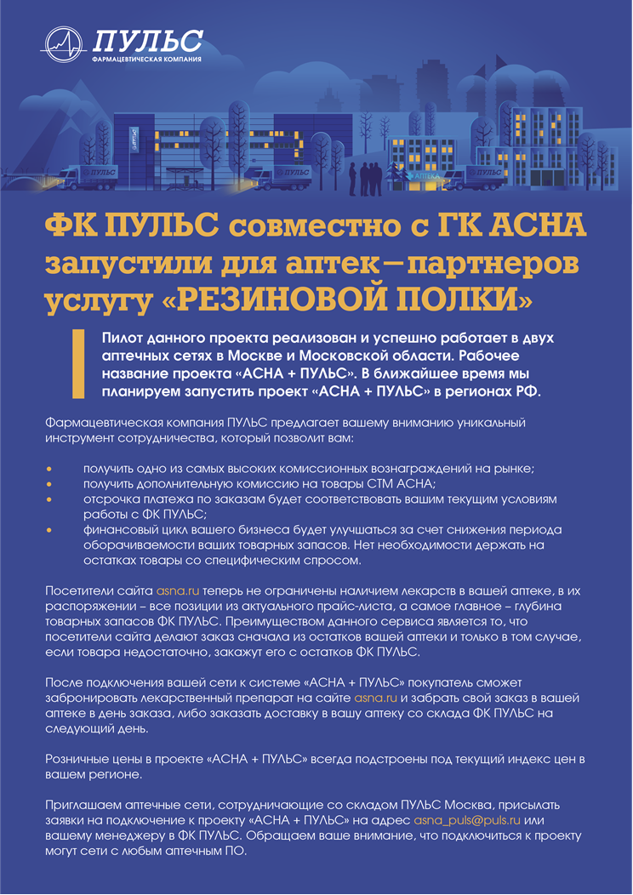
Project "Rubber shelf"
In 2020, FC PULSE together with GC ASNA launched the "RUBBER SHELF" service for partner pharmacies
Visitors to the site asna.ru are no longer limited by the availability of drugs in a particular pharmacy, they have at their disposal all items from the current price list, and most importantly, the depth of FC PULSE stocks.
After connecting the pharmacy network to the “ASNA + PULSE” system, the costumer will be able to book a drug on the asna.ru website and pick up his order at the pharmacy on the day of ordering, or order delivery to the pharmacy from the FC PULSE warehouse on the next day.
Benefits for pharmacies:
- one of the highest commissions on the market;
- additional commission for goods of private label ASNA;
- deferred payment for orders will correspond to the current conditions of work with FC PULSE;
- the financial cycle of the business will improve by reducing the turnover period of the pharmacy inventory => it is not necessary to keep on stock goods with specific demand

Slide 14

Marketing Union "CONSTELLATION"
In order to preserve the versatility of the pharmaceutical market and provide equal opportunities to all participants, the national pharmaceutical distributor PULSE has created and is developing the marketing union "SOZVEZDIE" - an association of independent participants in the pharmaceutical market: pharmacies, manufacturers and a software product integrator.
Today MS "SOZVEZDIE" unites more than 4,400 "non-chain" pharmacies, which successfully compete with federal chains.
Plans for 2021 include cooperation with more than 5,500 pharmacies.

Slide 15
Advantages of cooperation with FC PULSE
High logistics standards Full compliance of storage and transportation of products with the manufacturer's requirements and Russian legislation
Full coverage of the Russian Federation 14 logistics complexes provide supplies to all regions of the Russian Federation
Direct contracts with manufacturers Direct centralized deliveries are a guarantee of the authenticity of all products
Quality service We guarantee accurate assembly and on-time delivery
Efficiency We are constantly working to reduce costs in order to provide our customers with the lowest possible prices
Reception and processing of applications in a convenient form Our clients can place an application using the electronic ordering program, through electronic platforms, as well as by phone or e-mail
Prompt provision of information All the necessary information for our partners
is online in the personal account

Slide 16


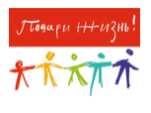
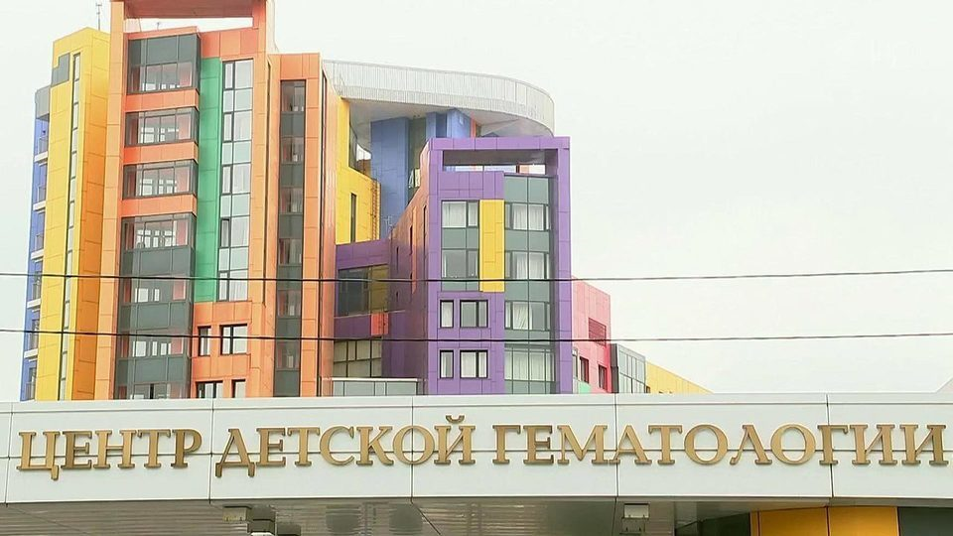
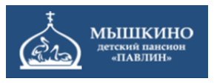
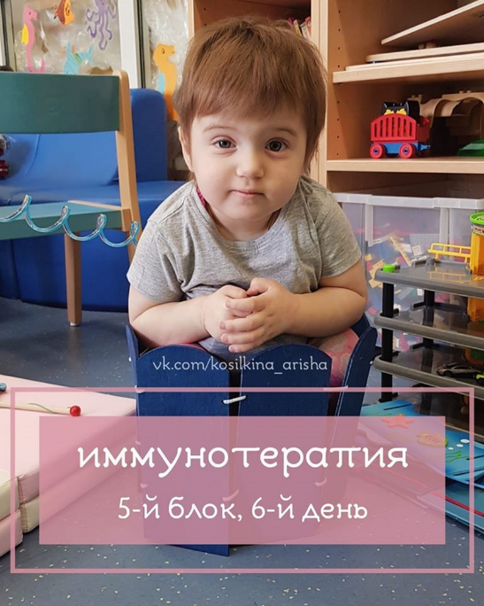
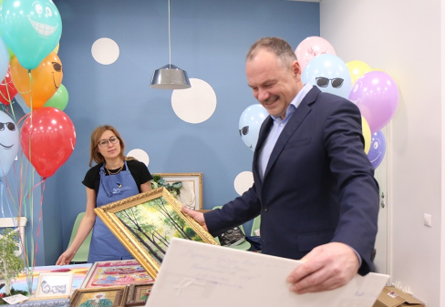
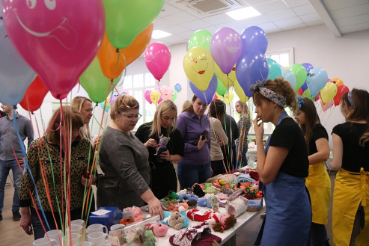
Charity: a year of good deeds
In 2020, FC PULSE donated more than 60 million rubles for charitable purposes. Behind these numbers are the lives and health of people who need help the most.
Charity for PULSE employees has long become the norm. For many years PULSE has been cooperating with various charitable foundations, the Dmitry Rogachev Center, boarding schools for the elderly. In the parent company of FC PULSE, charity fairs are held, and employees monthly transfer funds to charitable foundations to help sick children.
But the anniversary year 2021 will be special. The company's management decided to declare it the year of charity, the year of good deeds. If earlier charitable projects were implemented mainly in Moscow and the Moscow region, now charitable assistance will be organized in every region of the country, and every employee of the PULSE company will be able to become participants in the corporate charity program, regardless of which city in Russia he lives.

Slide 17

Mission
FC PULSE is a company based on trusting, honest relationships with partners and employees. We build our business based on values ​​and traditions that have not changed since the foundation of the company. It is important for us to share our success with people who are engaged in common business with us. We see our development in the joint solution of the problems that face us and our clients.
We are constantly working on the efficiency of business processes and cost optimization. Thanks to this we offer our clients the best conditions.
Quality service is our pride.
We provide our suppliers with reliable cooperation and the opportunity to be represented in every region of our country.
We give our employees a sense of self-confidence and the opportunity for professional development
Together we make medicines available.

Slide 18

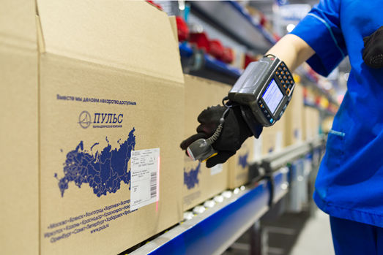
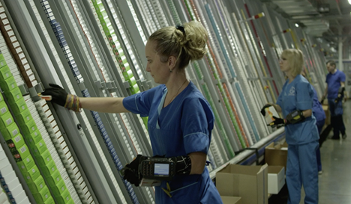
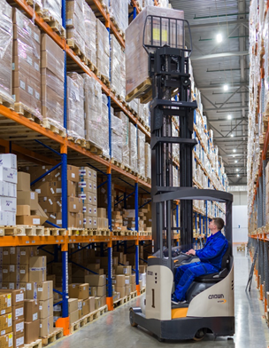
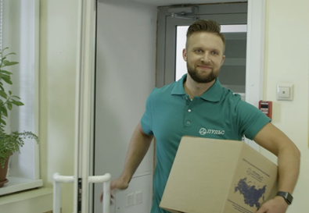
Company values
Professionalism
This is reliability multiplied by the result, high quality standards of our work and responsibility for the obligations assumed.
Ambition
We are not afraid to solve the most difficult problems, we are proud of our achievements and the achievements of our partners.
Teamwork
Each member of our team is interested in the common success and is ready to support our clients. The synergy effect is possible only in a team - this is the key to our effectiveness.
Positive attitude
This is the foundation on which our attitude to life and work is built. Optimism helps us see opportunities where others see problems.

Slide 19
We are sure that in cooperation we can make your and our business even more successful!
www.puls.ru

